Slide 1
Spring MVC

Slide 2
Spring MVC
Spring MVC is a Java framework which is used to build web applications.
It follows the Model-View-Controller design pattern.
It implements all the basic features of a core spring framework like Inversion of Control, Dependency Injection.
A Spring MVC provides an elegant solution to use MVC in spring framework by the help of DispatcherServlet.
DispatcherServlet is a class that receives the incoming request and maps it to the right resource such as controllers, models, and views.
Notes:
Provides a good alternative to EJB for most applications
Provides end-to-end framework for applications.

Slide 3
Advantages of Spring MVC Framework
Separate Roles
Light Weight
Powerful Configuration
Rapid Development
Reusable business code
Easy to test
Flexible Mapping
Notes:
Provides a good alternative to EJB for most applications
Provides end-to-end framework for applications.

Slide 4
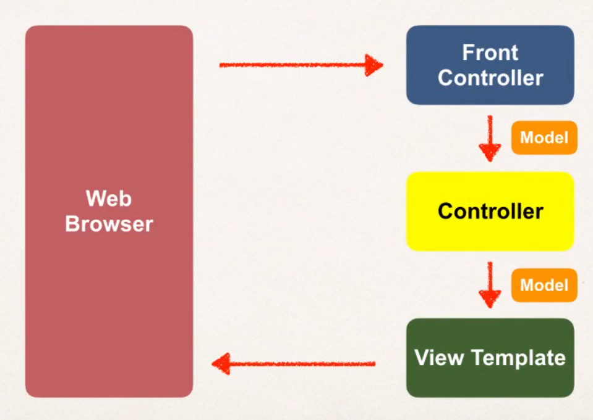
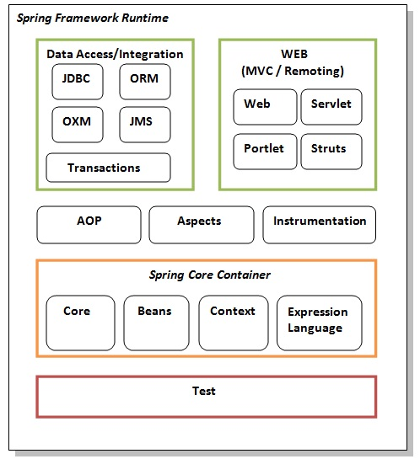
Flow of Spring MVC

Slide 5
Spring MVC - Configuration Process
Configure Spring MVC Dispatcher Servlet (Front Control)
Set up URL mapping to spring MVC Dispatcher Servlet
Add support for spring component scanning
Add support for Conversion, formatting & validation
Configure Spring MVC View Resolver

Slide 6
Spring Controller and View
@Controller
Spring Controller annotation can be applied on classes only.
It’s used to mark a class as a web request handler
@RequestMapping
This annotation is used to map web requests to Spring Controller methods.

Slide 7
Spring - Controller and View
Development Process
Create a Controller Class (@Controller)
Define Controller method
Add Request Mapping to Controller Method (@RequestMapping)
Return view Name
Develop view page

Slide 8
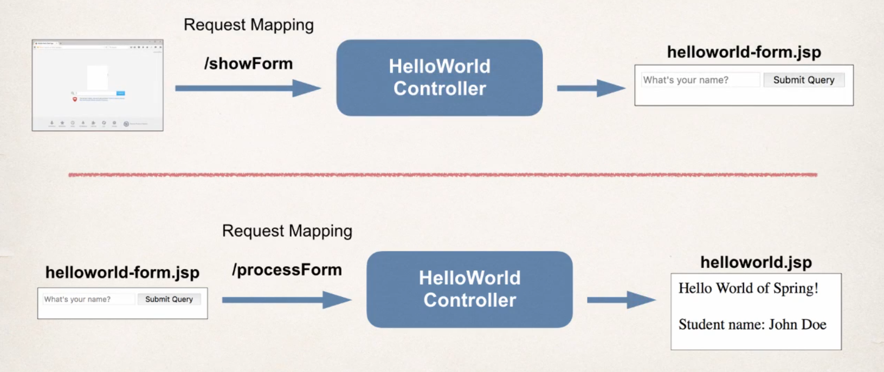
How to Read Form Data

Slide 9
How Read Form Data – Development Process
Create Control Class
Show HTML Form
Create Controller method to show HTML form
Create view page for HTML form
Process HTML Form
Create Controller method to show HTML form
Develop view page for HTML form

Slide 10
Model
Adding Data to the Model
HttpServletRequest
To Read the form data in our Controller Cod
Model
Container of Data
Syntax
model.addAttribute(“AttributeName”, data)
(We will explain Code here)

Slide 11
Read Form Data - @RequestParam
It will read parameter and bind it to the variable.
Syntax
@RequestParam(“parameter") String Variable
Controller Request Mapping
Serves as parent mapping for controller
All the requests mapping in the controller are relative
(We will explain code here)

Slide 12
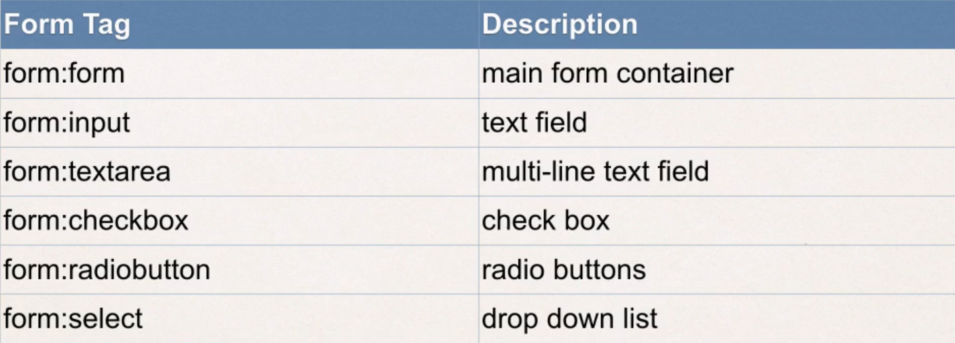
Spring MVC - Form Tags
Tags are building blocks for Web Page
They are Configurable and Reusable
Supports, Data Binding - Automatically Setting / Retrieving data from a Java Object / Bean

Slide 13
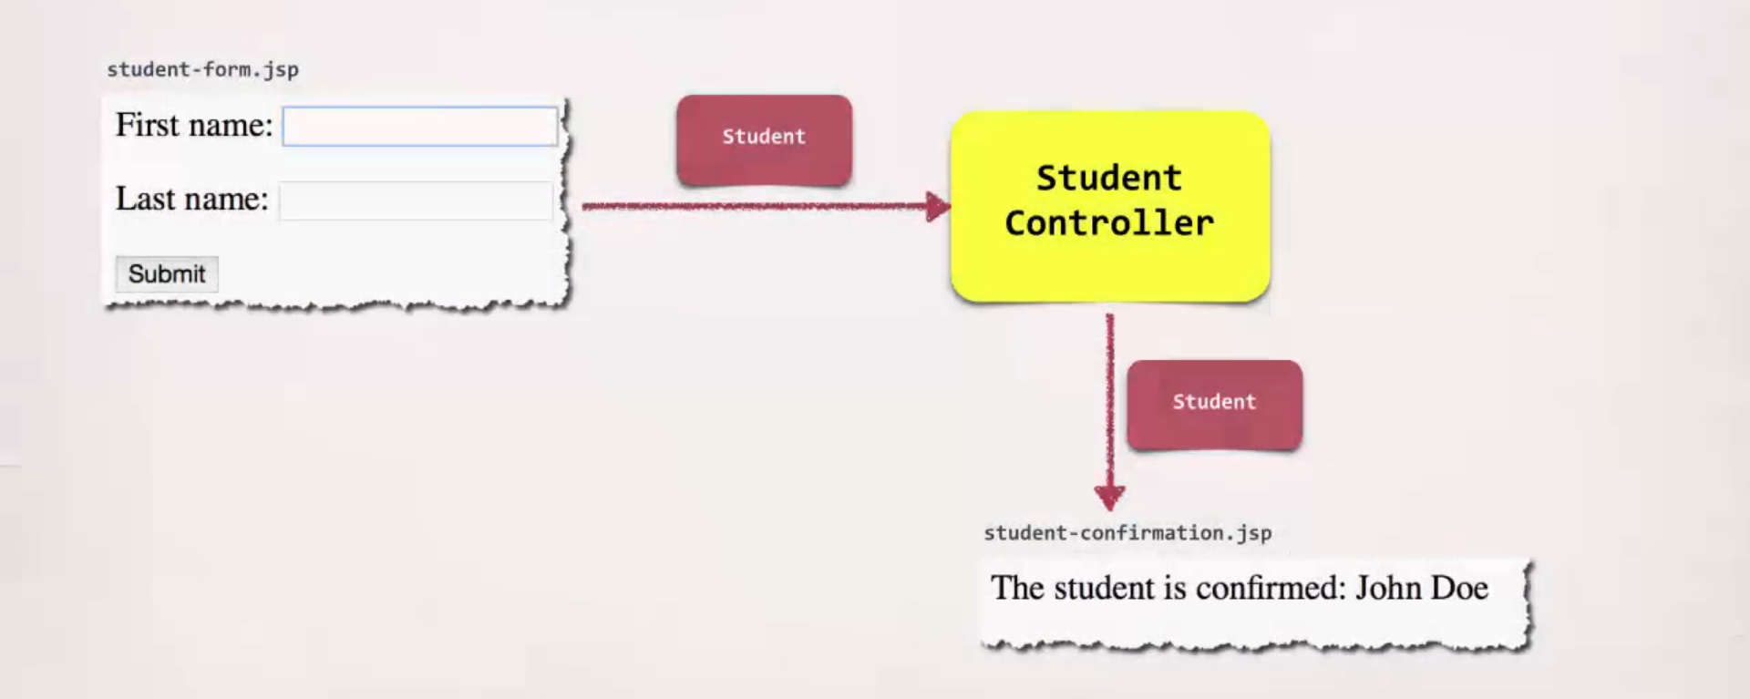
Example

Slide 14
Development Process
Create a Student Class
Create a Student Controller Class
Create HTML form
Create form Processing code
Create Confirmation Page
(We will explain Code here)

Slide 15
Spring MVC - Validation
Need Of Validation
For Required Fields
Validate Number Range
Validate Format (Postal Code)
Custom Business Rule

Slide 16
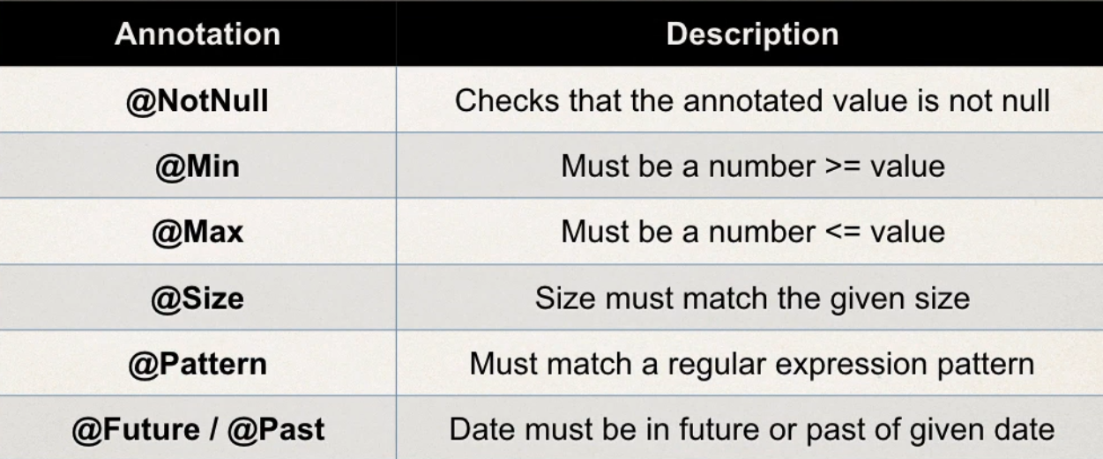
Valid Annotations

Slide 17
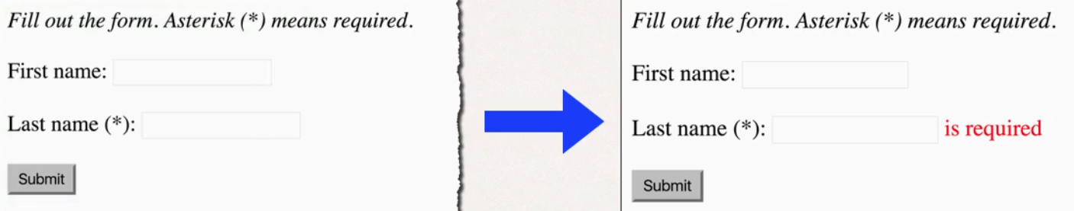
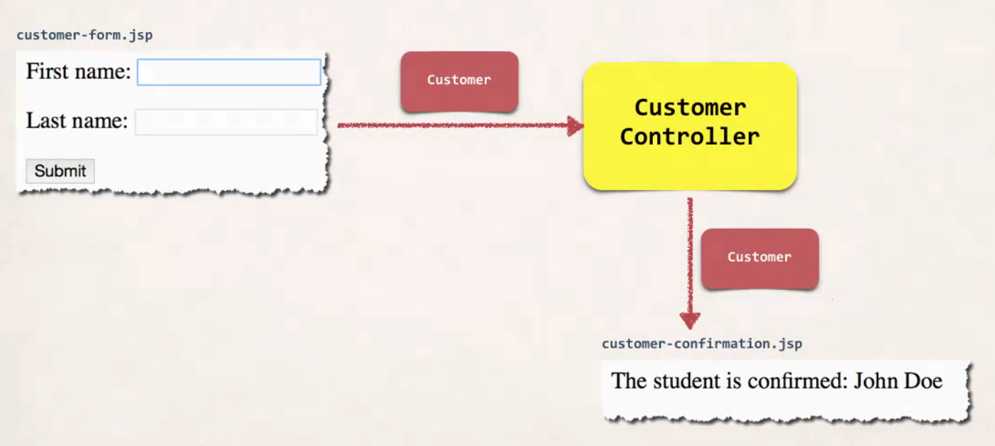
Example – Text Field

Slide 18
Development Process
Add a Validation Rule to Customer lass
Display Error message on HTML
Perform Validation on Control class
Update Confirmation page
(We will explain Code here)

Slide 19
Thank You

